Slide 1
Movie Sentiment Analysis: From Data to Deployment
Team San Francisco
1. Jacob O. Jaroya
2. Felix Kiprotich
3. Sylvester Ampomah
4. Kingsley Yaw Siedu
5. Jedida M. Kisiang'Ani

Slide 2
Project Brief
In the digital age, opinions about movies are everywhere - from social media to dedicated review platforms. But what if you could harness the power of natural language processing (NLP) to instantly gauge the sentiments expressed in these reviews? This presentation takes you on a journey through the creation of a movie sentiment analysis application, from its inception to deployment

Slide 3
Importation of Important Libraries
The following code snippet was used to load the necessary libraries:
#Import Libraries
import os
#Data manipulation
import pandas as pd
import numpy as np
import datasets
from sklearn.model_selection import train_test_split
import collections
import emoji
import matplotlib.pyplot as plt
from wordcloud import WordCloud
import nltk
from nltk.corpus import stopwords
import re
import seaborn as sns
#finetuning
from transformers import AutoTokenizer
from transformers import TrainingArguments
from transformers import AutoModelForSequenceClassification
from transformers import Trainer
import torch
from torch.utils.data import DataLoader

Slide 4
Importation of Important Libraries cont’d..
#Evaluation
from datasets import load_metric, load_dataset
from sklearn.metrics import f1_score
from huggingface_hub import notebook_login
# Statistics
from scipy.stats import chi2_contingency

Slide 5
Brief documentations on the Libraries
1. os:
Purpose: The os module provides a portable way to use operating system-dependent functionality, such as reading or writing to the file system, working with file paths, etc.
Use: It is commonly used for file and directory manipulation.
2. pandas (pd):
Purpose: Pandas is a powerful data manipulation library. It provides data structures like DataFrames and Series, which are useful for data cleaning, exploration, and analysis.
Use: You can use it for reading, writing, and manipulating structured data.
3. numpy (np):
Purpose: NumPy is a library for numerical computations in Python. It provides support for large, multi-dimensional arrays and matrices.
Use: It's widely used for mathematical and statistical operations on arrays.

Slide 6
Brief documentations on the Libraries cont’d..
4. datasets:
Purpose: The datasets library provides an easy way to download and work with various datasets for machine learning tasks.
Use: It simplifies data loading and preprocessing for tasks like natural language processing and computer vision.
5. sklearn.model_selection:
Purpose: This module from scikit-learn (sklearn) provides tools for splitting datasets into training and testing sets, as well as cross-validation.
Use: It's used for creating training and testing sets for machine learning models.
6. collections:
Purpose: The collections module provides specialized container datatypes, such as dictionaries and named tuples.
Use: It's useful for creating and manipulating data structures.

Slide 7
Brief documentations on the Libraries cont’d..
7. emoji:
Purpose: The emoji library allows you to work with emojis in Python.
Use: It can be used for tasks like emoji detection or manipulation in text data.
8. matplotlib.pyplot as plt:
Purpose: Matplotlib is a popular data visualization library. The pyplot module provides a simple interface for creating various types of plots and charts.
Use: It's used for creating visualizations and plots.
9. wordcloud.WordCloud:
Purpose: The WordCloud class from the wordcloud library is used for creating word clouds, which visualize the most frequent words in a text corpus.
Use: It's commonly used for text data visualization.

Slide 8
Brief documentations on the Libraries cont’d..
10. nltk:
Purpose: NLTK (Natural Language Toolkit) is a library for natural language processing (NLP) tasks. It provides tools for working with human language data.
Use: It's used for tasks like text tokenization, stemming, and stopword removal.
11. nltk.corpus.stopwords:
Purpose: This submodule from NLTK contains a list of common stop words in various languages.
Use: It's used for filtering out common, non-informative words from text data.
12. re:
Purpose: The re module provides support for regular expressions, which are powerful for text pattern matching and manipulation.
Use: It's used for text preprocessing and pattern matching.
.

Slide 9
Brief documentations on the Libraries cont’d..
13. seaborn (sns):
Purpose: Seaborn is a data visualization library based on Matplotlib. It provides a high-level interface for creating informative and attractive statistical graphics.
Use: It's used for creating complex and aesthetically pleasing data visualizations.
14. transformers.AutoTokenizer:
Purpose: The AutoTokenizer class from the Transformers library is used for tokenizing text data for various pre-trained language models.
Use: It's essential for preparing text data for NLP tasks.
15. transformers.TrainingArguments:
Purpose: TrainingArguments is a class from Transformers used for configuring training arguments for fine-tuning pre-trained models.
Use: It's used for specifying training parameters.

Slide 10
Brief documentations on the Libraries cont’d..
16. transformers.AutoModelForSequenceClassification:
Purpose: This class from Transformers is used for fine-tuning pre-trained models for sequence classification tasks.
Use: It's used for building and fine-tuning NLP models.
17. transformers.Trainer:
Purpose: The Trainer class from Transformers provides an interface for training and evaluating machine learning models.
Use: It simplifies the training process for NLP models.
18. torch:
Purpose: PyTorch is an open-source deep learning framework. The torch module provides a wide range of tools for building and training neural networks.
Use: It's a fundamental library for deep learning.

Slide 11
Brief documentations on the Libraries cont’d..
19. torch.utils.data.DataLoader:
Purpose: This class from PyTorch provides an efficient way to load and iterate over datasets, making it suitable for data batching and parallel processing during training.
Use: It's used for creating data loaders for training neural networks.
20. datasets.load_metric:
Purpose: This function from the datasets library loads evaluation metrics for various machine learning tasks.
Use: It's used for evaluating model performance.
21. datasets.load_dataset:
Purpose: This function from the datasets library is used to load datasets for various machine learning tasks.
Use: It simplifies the process of loading datasets.

Slide 12
Brief documentations on the Libraries cont’d..
22. sklearn.metrics.f1_score:
Purpose: This function from scikit-learn computes the F1 score, which is a common metric for binary and multiclass classification tasks.
Use: It's used for evaluating classification model performance.
23. huggingface_hub.notebook_login:
Purpose: This function allows you to log in to the Hugging Face Model Hub from a Jupyter notebook.
Use: It's useful when working with Hugging Face's model sharing platform.
24. scipy.stats.chi2_contingency:
Purpose: This function from SciPy is used for the chi-squared test of independence, which is a statistical test for the association between categorical variables.
Use: It's used for conducting chi-squared tests.

Slide 13
Loading the Datasets
To load the datasets, the code utilized the google colab environment and google drive for data storage. The steps involved were as follows:
Mounting google drive:
The first line of code imports the drive module from the google.colab library and then mounts the Google Drive to the Colab environment. This allows you to access files stored in your Google Drive.
from google.colab import drive
drive.mount('/content/drive')

Slide 14
.
2. Loading the training and testing data:
The next step is to load the datasets. This is done using the pd.read_csv() function from the pandas library. It reads the CSV files located in the specified Google Drive directory.
# Load the training dataset
train_df = pd.read_csv('/content/drive/MyDrive/Movie_Datasets/Train.csv')
# Load the testing dataset
test_df = pd.read_csv('/content/drive/MyDrive/Movie_Datasets/Test.csv')

Slide 15
.
3. Checking the Train and Test Datasets:
After loading, the code prints out the first few rows of both the training and testing datasets. This provides a preview of the data structure.
# Check the train dataset
train_df
# Check the test dataset
test_df
The output displayed the structure of both datasets, including the columns ('review_file', 'content', 'sentiment' for the training set and 'review_file' and 'content' for the testing set) and the first few rows.

Slide 16
Exploratory Data Analysis (EDA)
Generate a wordcloud from ‘content’ column
The code snippet below generates a wordcloud which we can then visualize.
# Generate a word cloud from the message text data
text = " ".join(sentence for sentence in train_df.content)
wordcloud = WordCloud(width=800, height=400, max_font_size=200, background_color="white")
# Generate the word cloud
wordcloud.generate(text)
# Display the word cloud image
plt.figure(figsize=(16,8))
plt.imshow(wordcloud, interpolation='bilinear')
plt.axis("off")
plt.show()

Slide 17
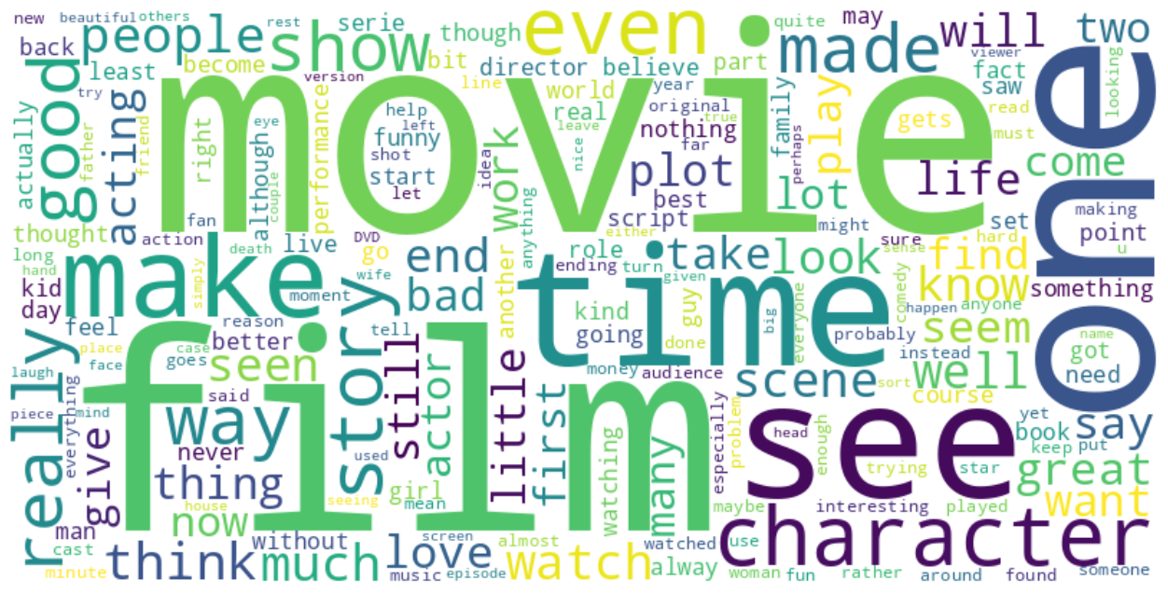
Word cloud from ‘content’ column

Slide 18
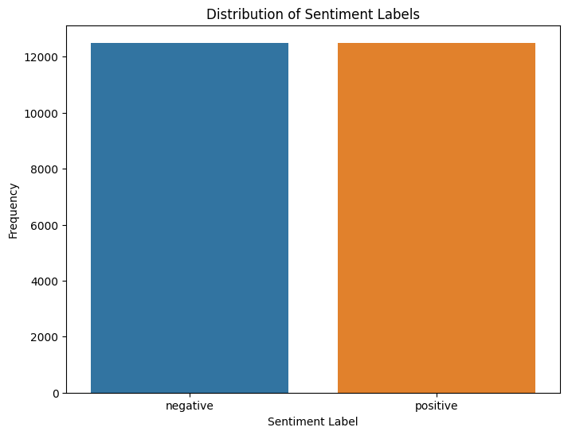
sentiment distribution We are able to show the distribution of sentiments from the train dataset
From the bar graph, we are able to see that the sentiments are equally distributed in the dataset

Slide 19
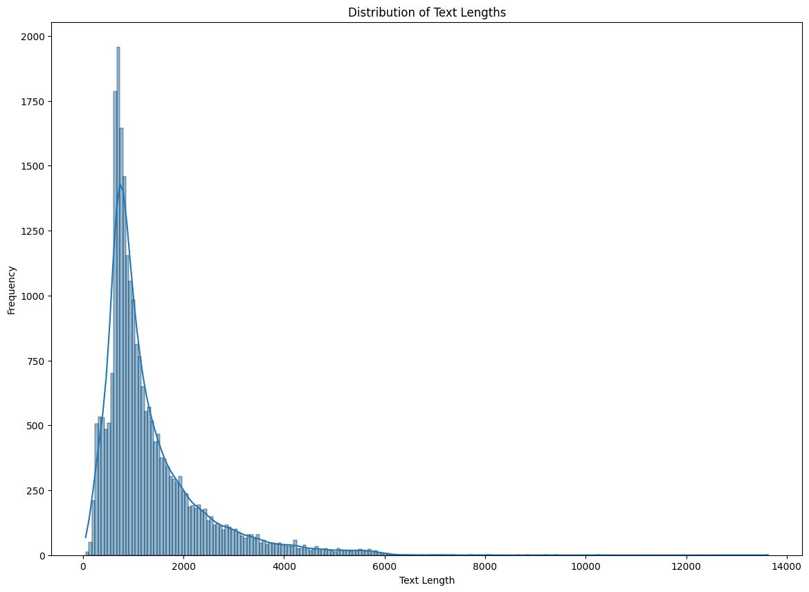
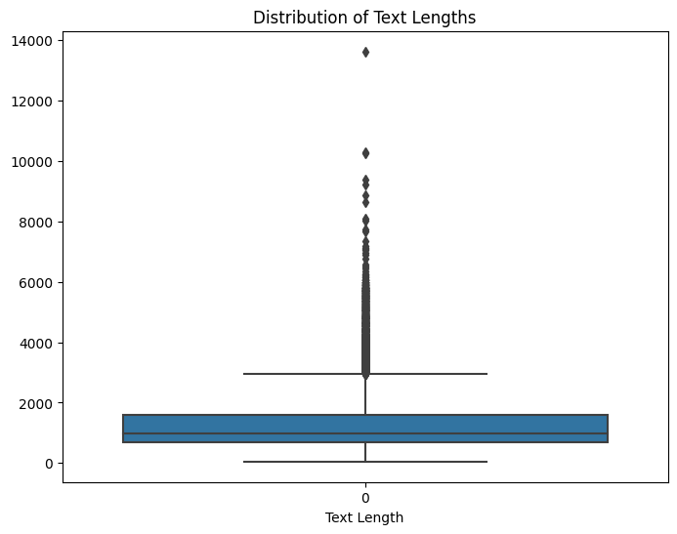
text length analysis. We are able to Visualize the distribution of text lengths using histograms or box plots.
From the Histogram, the distribution appears to be right-skewed, indicating that there are relatively few texts with very short lengths and a larger number of texts with longer lengths.

Slide 20
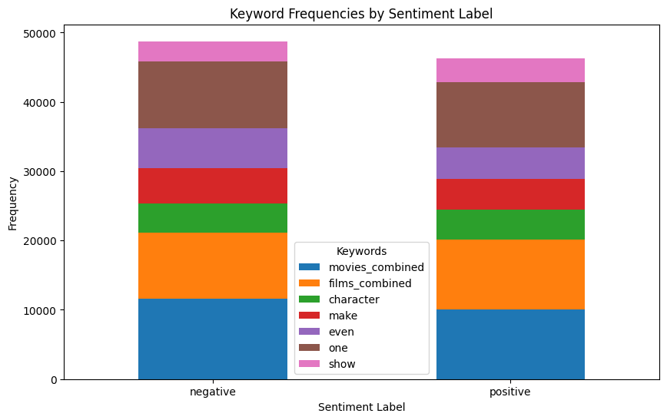
Keyword Frequencies by Sentiment Label The chart below allows us to compare the distribution and relative frequencies of keywords across different sentiment categories.
We can conclude that these commonly used words in the sentences are almost uniformly distributed in their usage between the two sentiments with a slightly more usage of the word(s) “movie(s)” in negative sentiment.

Slide 21
Model training
We delve into model building, selecting from the vast world of Natural Language Processing (NLP) models. BERT, DistilBERT, and RoBERTa are popular choices. Each has its strengths, and our choice depends on factors like model size and accuracy.
The first step before training the models is to create a tokenizer instance. The line of code below initializes a tokenizer for the "sentence_sentiments_analysis_bert" model using the transformers library. The tokenizer is an essential component for processing text data and is used to convert input text into tokens that can be fed into the model for sentiment analysis.
#Create a tokenizer instance
tokenizer=AutoTokenizer.from_pretrained('bert-base-cased')

Slide 22
Model training cont’d..
Since some sequences might be longer than the length of 512 allowable for BERT, DistilBERT, and RoBERTa models, it is important to divide then into chunks of 512 as shown in the code below.
# Chunk size for dividing longer sequences
chunk_size = 512 # Adjust this based on the length of the tokens

Slide 23
Model training cont’d..
The second step is to create functions to tokenize text and transform labels. We shall need two functions to do the following:
tokenize_data(data): This function takes a dictionary-like data object as input, which is assumed to have a 'content' field containing the text to be tokenized.
transfom_label(data): This function takes a dictionary-like data object as input, which is assumed to have a 'sentiment' field containing the sentiment label ('positive' or 'negative').
These steps are illustrated in the code snippet in the next slide:

Slide 24
Model training cont’d..
Code snippet:
def tokenize_data(data):
content = data['content']
tokens = tokenizer(content, padding='max_length', truncation=True, max_length=chunk_size, return_tensors='pt')
return tokens
#function to transform labels
def transfom_label(data):
#extract label
label=data['sentiment']
num=0
#create conditions
if label=='negative':
num=0
else:
num=1 #Positive
return {'labels':num}

Slide 25
Model training cont’d..
The third step is to tokenizer text and transform original sentiment labels. This is achieved by the code below:
#The following columns will be removed after tokenization
remove_columns = ['review_file', 'content', 'sentiment']
#Tokenize the text data
datasets = datasets.map(tokenize_data, batched=True)
#transform the labels
datasets=datasets.map(transfom_label,remove_columns=remove_columns)

Slide 26
Model training cont’d..
The fourth step is to extract the train and eval datasets from datasets as shown in the code snippet below:
#extract train datasets
train_dataset=datasets['train'].shuffle(seed=42)
#extract eval datasets
eval_dataset=datasets['eval'].shuffle(seed=42)
The next step is to define metrics function as shown below:
# Define the function to compute F1-score
def compute_metrics(eval_preds):
logits, labels = eval_preds
predictions = np.argmax(logits, axis=-1)
f1 = f1_score(labels, predictions, average='weighted')
return {"f1-score": f1}

Slide 27
Model training cont’d..
The above function works as follows:
1. logits: This array contains the predicted scores or probabilities for each class produced by the model. Each row corresponds to a data point, and each column corresponds to a class. The values in the logits array indicate how strongly the model believes each class is present in the data point.
2. labels: This array contains the true labels or ground truth for each data point. These are the actual classes to which the data points belong.
3. predictions: The np.argmax function is used to find the index of the highest predicted score (probability) in the logits array for each data point. This index corresponds to the predicted class label for that data point.
4. f1_score(labels, predictions, average='weighted'): This computes the F1-score using the f1_score function from the sklearn.metrics module. The F1-score is a metric that combines precision and recall to provide a balanced measure of a model's accuracy. It's particularly useful when dealing with imbalanced classes.
5. return {"f1-score": f1}: The function returns a dictionary containing the calculated F1-score with the key "f1-score". This format is suitable for reporting and tracking multiple metrics during model evaluation.

Slide 28
Model training cont’d..
Three models shall be trained in turns as follows:
1. 'bert-base-cased' and be named as: 'sentence_sentiments_analysis_bert'
2. 'distilbert-base-cased' and be named as: 'sentence_sentiments_analysis_distilbert'
3. 'roberta-base' and be named as: 'sentence_sentiments_analysis_roberta'

Slide 29
Model training cont’d..
Just before we start training we need to do the following:
(i) Set the training arguments. The TrainingArguments object is used to define various training configurations and hyperparameters, such as the number of training epochs, evaluation and saving strategies, and whether to push the model to the Hugging Face Model Hub after training. This object is then passed to the Trainer class for model training using the specified settings. This is shown in the code snippet below:
#set the training arguments
trainargs=TrainingArguments('sentence_sentiments_analysis_bert',
num_train_epochs=5,
evaluation_strategy="epoch",
save_strategy='epoch',
load_best_model_at_end=True,
push_to_hub=True)

Slide 30
Model training cont’d..
(ii) Create instance of the model.
The code below creates a pre-trained sequence classification model with two output labels and initializes it with the pre-trained weights from the model. This model can be fine-tuned for a specific classification task, such as sentiment analysis, with the appropriate training data.
# Create an instance of the BERT model
model_name = 'bert-base-cased'
num_labels = 2
model = AutoModelForSequenceClassification.from_pretrained(model_name, num_labels=num_labels)

Slide 31
Model training cont’d..
(iii) Create trainer instance. The code below creates a Trainer instance with the necessary components, including the model, training and evaluation datasets, tokenizer, and a function for computing evaluation metrics. The Trainer instance can be used to train and evaluate the pre-trained sequence classification model on the specified datasets using the defined training arguments.
# Create a Trainer instance
trainer = Trainer(
model=model,
args=trainargs,
train_dataset=train_dataset,
eval_dataset=eval_dataset,
tokenizer=tokenizer,
compute_metrics=compute_metrics,
)

Slide 32
Pushing Trained Models to Hugging Face
Once we've trained our models, we can contribute them to the Hugging Face Transformers Hub. This not only shares our models with the community but also enables seamless integration into web applications. The trained models cards from hugging face is illustrated by showing that of the Bert model below:

Slide 33
Pushing Trained Models to Hugging Face
sentence_sentiments_analysis_bert
This model is a fine-tuned version of bert-base-cased on an unknown dataset. It achieves the following results on the evaluation set:
• Loss: 0.3401
• F1-score: 0.9007
Training procedure
Training hyperparameters
The following hyperparameters were used during training:
learning_rate: 5e-05
train_batch_size: 8
eval_batch_size: 8
seed: 42
optimizer: Adam with betas=(0.9,0.999) and epsilon=1e-08
lr_scheduler_type: linear
num_epochs: 5

Slide 34
Pushing Trained Models to Hugging Face

Slide 35
Testing the Models with Test Data
Testing is crucial. We use a separate test dataset to evaluate the models' performance. Metrics like accuracy, precision, and recall are vital in assessing how well our models can predict sentiments. We shall use test_df dataset to see how the trained models would predict the sentiments.
Let us look at the results of the sentiments outcome from one of the three models, Roberta using the code snippet below:
# Already predicted sentiments added to 'predicted_sentiment' column
selected_columns = ['review_file', 'predicted_sentiment']
result_df = test_df.loc[:, selected_columns]
# Display 'result_df' contents of only the 'review_file' and 'predicted_sentiment' columns
print('Roberta Model: Predicted Sentiments on Test Data')
print('==============================================')
result_df.head(10)

Slide 36
Testing the Models with Test Data
Roberta Model: Predicted Sentiments on Test Data
=================================
review_file predicted_sentiment
0 0_10.txt positive
1 0_2.txt negative
2 10000_4.txt negative
3 10000_7.txt positive
4 10001_1.txt negative
5 10001_9.txt positive
6 10002_3.txt negative
7 10002_8.txt positive
8 10003_3.txt negative
9 10003_8.txt positive

Slide 37
Testing the Models with Test Data
The Distribution of predicted_sentiment for Roberta model can be shown with the code snippet below:
# Calculate the frequency of each predicted sentiment label
sentiment_counts = test_df['predicted_sentiment'].value_counts()
sentiment_counts
positive 12997 negative 12003
Name: predicted_sentiment, dtype: int64

Slide 38
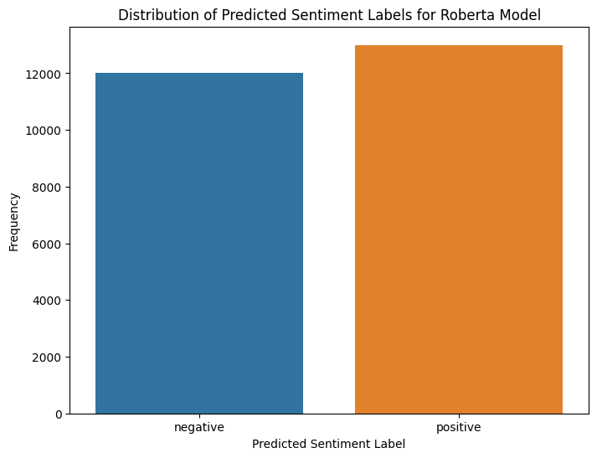
Testing the Models with Test Data
The Visualization of sentiment_counts for Roberta Model is shown in the Figure below:

Slide 39
Hypothesis Testing on Models' Performance
To ensure we've selected the right model, we can conduct hypothesis testing. Statistical tests help us compare the models' performance and determine if the models are significantly different or not in their performances.
The common statistical test for comparing proportions or success rates between two or more groups is the chi-squared test (χ² test). In our case, you want to compare the proportions of positive and negative predictions made by each model.
So we shall formulate our hypothesis as follows:
1. Null Hypothesis (Ho): There is NO significant difference between the models
2. Alternative Hypothesis (H1): There is significant difference between the models

Slide 40
Hypothesis Testing on Models' Performance
The code snippet below works out the χ² test:
# Create a contingency table (observed frequencies)
observed = df[["Positive", "Negative"]].values
# Perform the chi-squared test
chi2, p, _, _ = chi2_contingency(observed)
# Degrees of freedom
degrees_of_freedom = (observed.shape[0] - 1) * (observed.shape[1] - 1)
# Print the results
print(f"Chi-squared statistic: {chi2:.2f}")
print(f"P-value: {p:.4f}")
print(f"Degrees of freedom: {degrees_of_freedom}")
# Interpret the results
alpha = 0.05 # Set the significance level
if p < alpha:
print("There is evidence of a significant difference between the models.")
else:
print("There is no evidence of a significant difference between the models.")

Slide 41
Hypothesis Testing on Models' Performance
The output of the above code is here below:
Chi-squared statistic: 97.98
P-value: 0.0000
Degrees of freedom: 2
There is evidence of a significant difference between the models.
From the result, we therefore reject the Null hypothesis and accept the Alternative Hypothesis (H1): that there is significant difference between the models. Meaning that each model behaves differently when predicting the sentiments.

Slide 42
App Development in Streamlit
With a trained model in hand, it's time to build the Movie Sentiment Analysis app. Streamlit, a fantastic tool for web app development, simplifies this process. Users can input a sentence or choose from predefined examples and select the model they prefer.
See the code in vscode….

Slide 43
Deployment of Streamlit App in Hugging Face
We aim to make our app accessible to a broader audience. Deploying it on Hugging Face's cloud platform is a fantastic way to achieve this. Users can access our app effortlessly through their web browsers.
Below is how the App appears in huggingface.

Slide 44

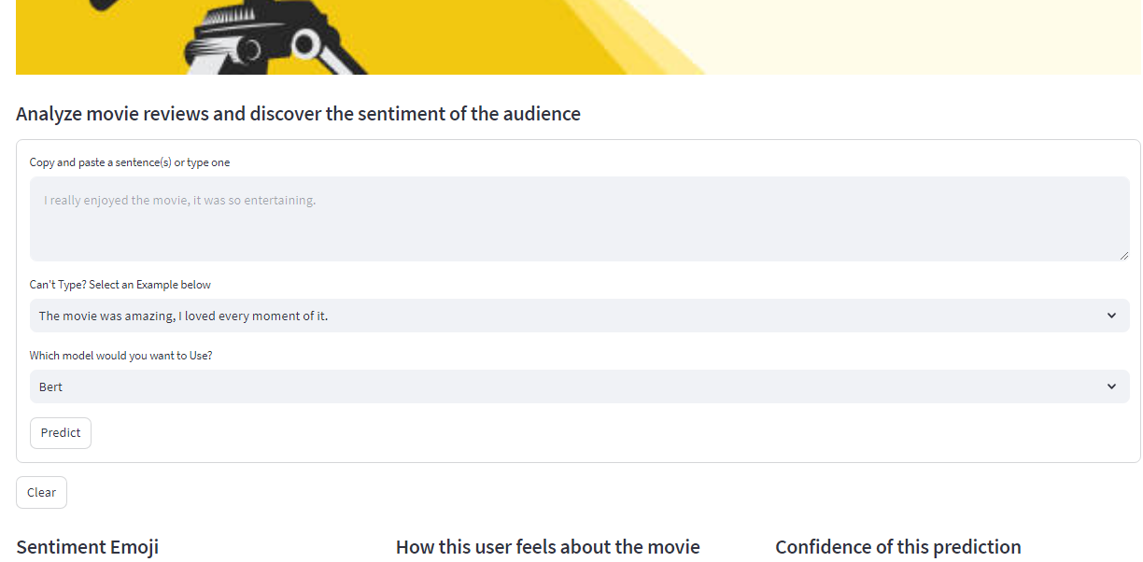
Deployment of Streamlit App in Hugging Face

Slide 45
Deployment of Streamlit App in Hugging Face
The use can then type in a sentence(s) or choose one of the option given then predict the sentiment about the movie. For example, if a use types in a statement like:
"Avengers: Endgame is an absolute masterpiece, seamlessly weaving together a decade of storytelling into an epic and emotionally satisfying conclusion."
The App input frontend will appear showing the typed sentence and the chosen model, here Distilbert has been picked as in the figure below:

Slide 46
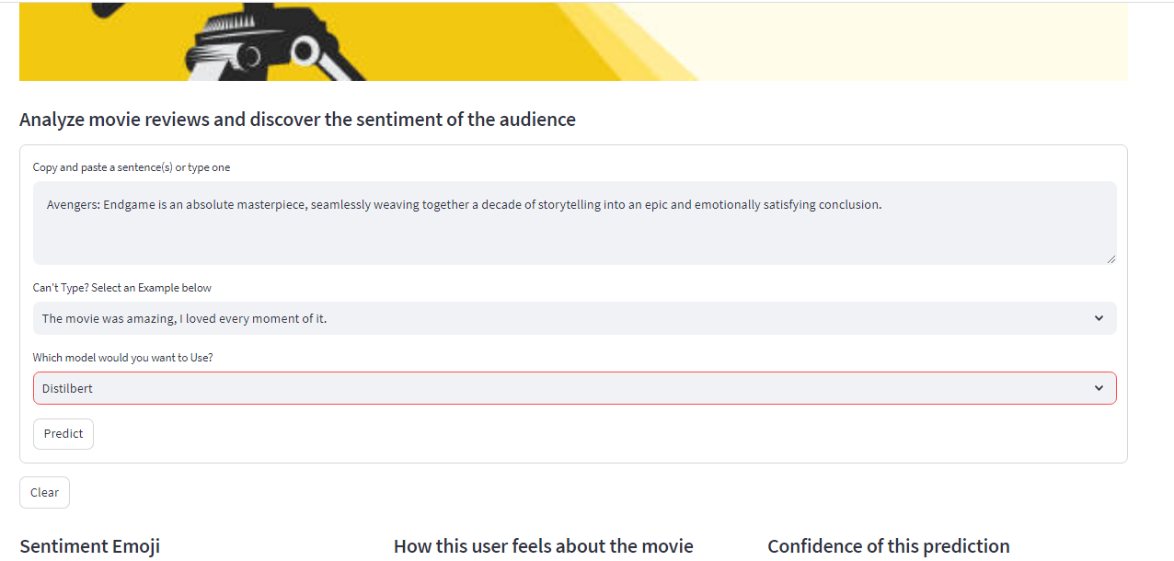
Deployment of Streamlit App in Hugging Face

Slide 47
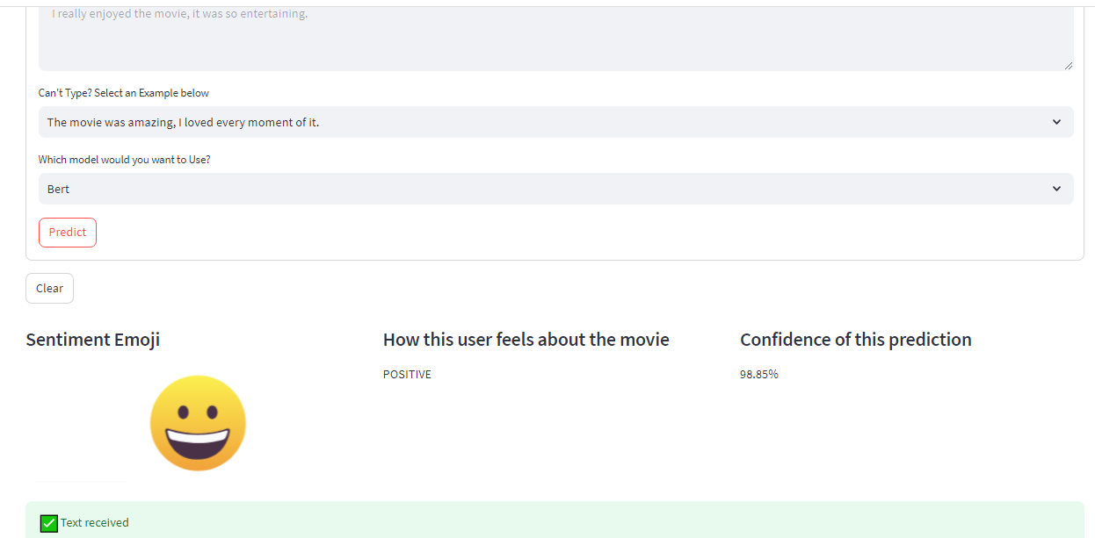
Deployment of Streamlit App in Hugging Face
And the output will appear as shown below:

Slide 48
Evaluation of App
The app isn't complete without evaluating its performance. We consider factors like user-friendliness, response time, and the accuracy of sentiment predictions.
The app truly shines in terms of user-friendliness, boasting an intuitive interface that ensures a smooth user experience. Additionally, the app excels in response time (under 10 seconds), delivering prompt and seamless interactions. Furthermore, it achieves remarkable accuracy in sentiment predictions (mostly above 90%), enhancing its overall performance and utility.

Slide 49
Conclusion
The Movie Sentiment Analysis app is a testament to the power of NLP and machine learning in understanding audience sentiments. It provides movie enthusiasts, critics, and curious individuals with quick insights into how the public perceives films.

Slide 50
Recommendations
To continue improving our app and exploring the world of NLP, we have several recommendations:
• Multi-Language Support: Extend the app's capabilities to analyze sentiments in multiple languages.
• Visualization: Incorporate interactive data visualizations to display sentiment trends over time or compare sentiments across different movies.
• Feedback Mechanism: Implement a feedback mechanism to collect user input and continuously improve the application.
• Custom Models: Allow users to upload and use their custom sentiment analysis models, expanding the range of choices.
• Error Handling: Enhance error handling to provide users with more informative messages in case of input errors.
With these recommendations, we can create a robust, versatile, and user-centric tool for exploring sentiments in movie reviews. The world of NLP is ever-evolving, and the possibilities for innovative applications are limitless. So, dive in, analyse your favourite movie reviews, and uncover the sentiments of the audience with the Movie Sentiment Analysis app. Enjoy exploring the world of sentiment analysis and NLP!

